Slide 1

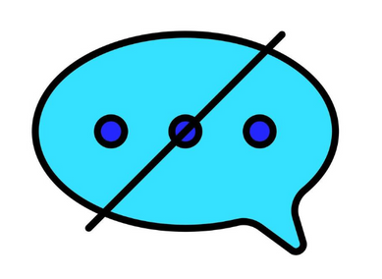

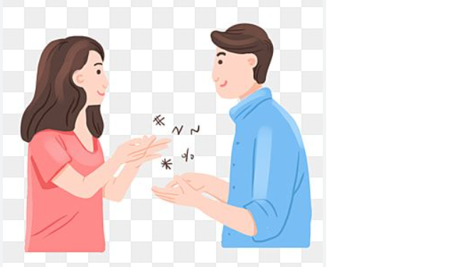
EC299 MINOR PROJECT
REAL-TIME SIGN LANGUAGE RECOGNITION TO SPEECH SYSTEM
PRESENTED BY:
Y.CHANAKYA -623191
V.JAHNAVI -623185

Slide 2

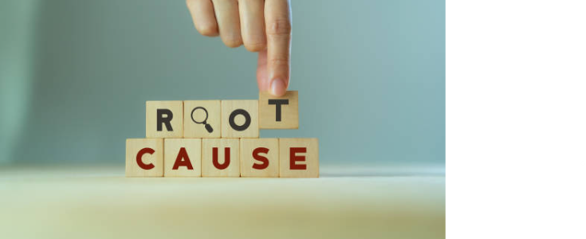
MOTIVE
A Heartfelt Realization :
One day, a deaf and mute person came to our class, asking for money for his education—unable to speak, unable to express his dreams. That moment made me realize that no one should struggle to be heard. This project is our way of giving them a voice.
Giving a Voice to Those Who Cannot Speak :
Everyone Deserves to Be Heard :
Imagine not being able to say ‘hello’ to a friend,ask for help,
or share your thoughts.For millions,this is a daily reality.
Communication is more than words; it’s about connection, emotions, and being understood. This system ensures that no one is left unheard.
Turning Gestures into Words, Silence into Conversations :
A simple hand movement can mean a world of emotions,
but not everyone understands sign language.
Our project breaks that barrier and make every conversation possible.

Slide 3
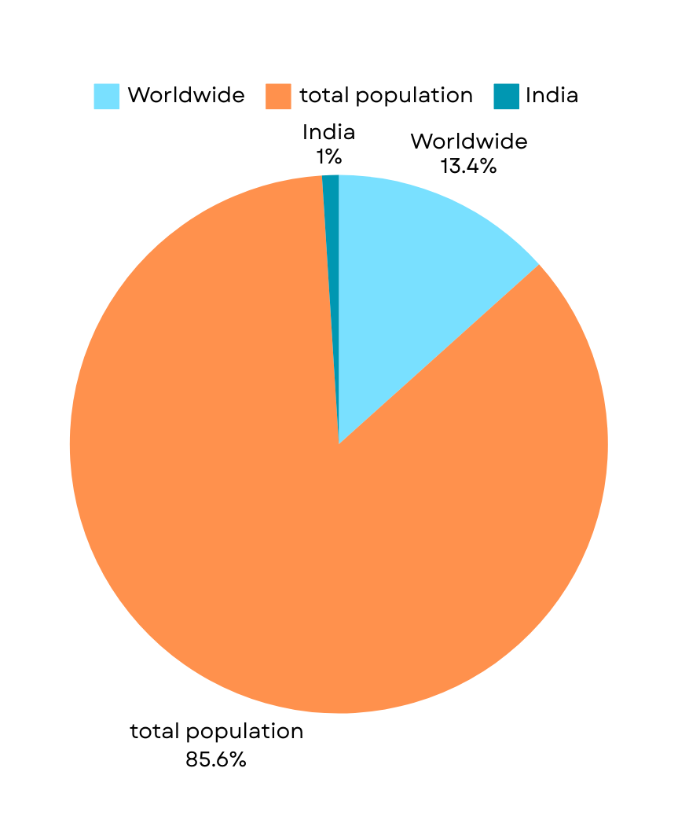
DEAF AND MUTE POPULATION DATA
According to W.H.O , Around 430 million people
all over the World suffer from this disability
According to W.H.O , Around 90 million people
all over the India suffer from this disability
According to W.H.O , Around 4 Lakh people
in Telangana suffer from this disability

Slide 4
ABSTRACT
Objective: Enable communication between deaf-mute individuals and the general population
Working Principle: Captures Hand gestures using camera and processes them to generate speech output
Technolgy used:
Image Processing: Extracts gesture features using techniques like Canny edge detection and contour analysis.
Hardware: Implemented on Microcontrollers/Raspberry Pi for real-time processing.
Speech Output: Converts recognized gestures into pre-recorded or synthesized speech using a speaker.
Impact: Empowers individuals with speech and hearing impairments, enhancing accessibility in daily life.

Slide 5
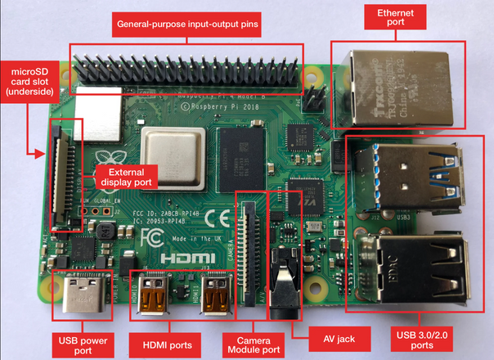
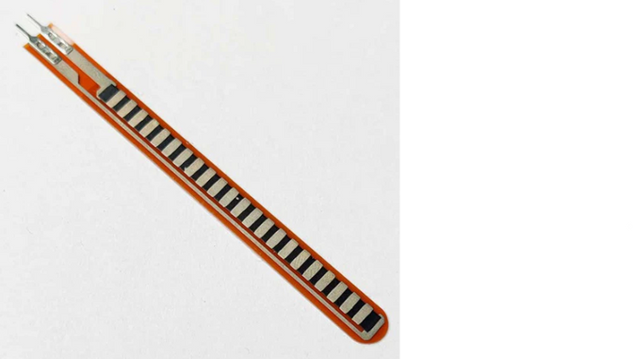
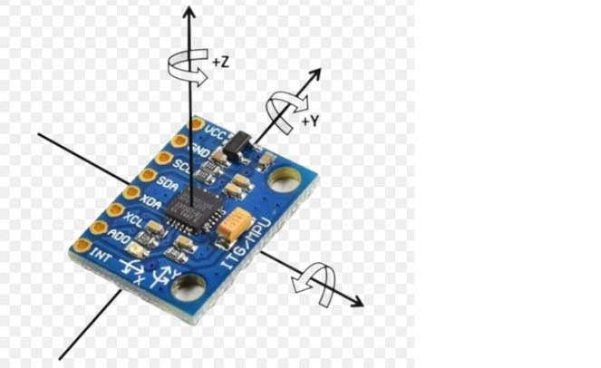
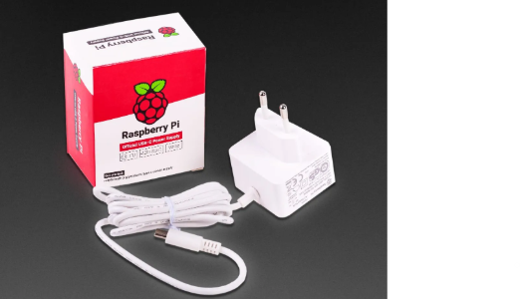
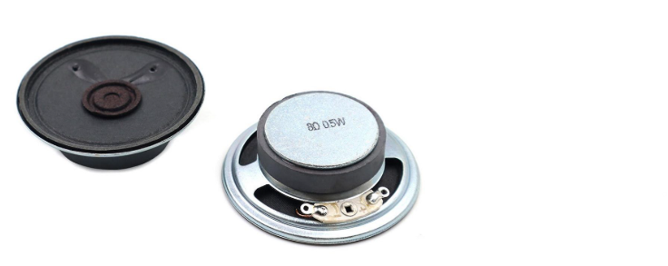
Components Required
Raspberry Pi
Flex Sensors
Accelerometer
MPU6050
Speakers (for voice output)
Power Supply
Acts as the main processing unit for image and signal processing, interfacing with sensors and running software (Python + OpenCV).
Used to detect the bending or flexing of a body part (such as fingers), which can be crucial for more precise sign recognition
Provides the necessary power to run the entire system, including the Raspberry Pi, sensors, camera, microphone, and speakers.
It helps in Orientation tracking ,It can sense the tilt or movement of the hand in space, which is important for understanding specific gestures or hand positions that go beyond simple finger movements.
It converts sign gestures into spoken language. Speakers allow the user to hear the translated message, making the system more interactive.

Slide 6
Workflow
STEP -1
Gesture Input
STEP-2
Image Processing and Feature Extraction using OpenCV
Flex Sensors(Finger Bends)+ Acclerometer(Hand Motion)
Raspberry Pi(Main Processor)
-Collects sensor data from
Flex and MPU6050
-Captures hand Image
(Camera Module)
-Converts Image to gray scale
-Applies gaussian blur and Noise Removal
-Detects edges using canny edge detection
-Find Contours of Hand
Gesture Mapping
-Compares extracted features with dataset
-Uses Predefined lookup table
-Maps gesture to text
This displayed text is synthesized to speech as output from speaker
Displays the recognised Text in LCD display
STEP-4
Displaying of text and Audio Output
STEP-3
Gesture Recognition

Slide 7
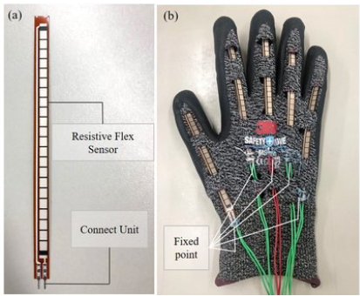
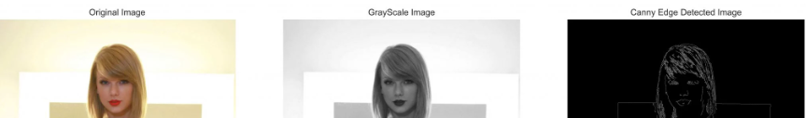
IMAGE PROCESSING TECHNIQUES FOR GESTURE RECOGNITION
GrayscaleConversion
Converts the image to shades of gray (0-255 intensity values), removing color information.
Reduces computational complexity while keeping shape details intact.
Gaussian Blur
Eliminates small, irrelevant details, making edge detection more accurate.
Applies a softening filter to reduce noise and smooth the image.
Canny Edge Detection
Detects the sharpest boundaries of an object using gradient changes and helps recognize hand contours effectively for gesture detection.
Flex Sensors & Accelerometer for Higher Accuracy
Flex Sensors: Detect finger bending, ensuring more detailed hand posture recognition.
Accelerometer (MPU6050): Captures hand movement (tilt & motion) for dynamic signs.
Combining image processing + sensor data significantly improves accuracy and reduces errors in recognition.

Slide 8
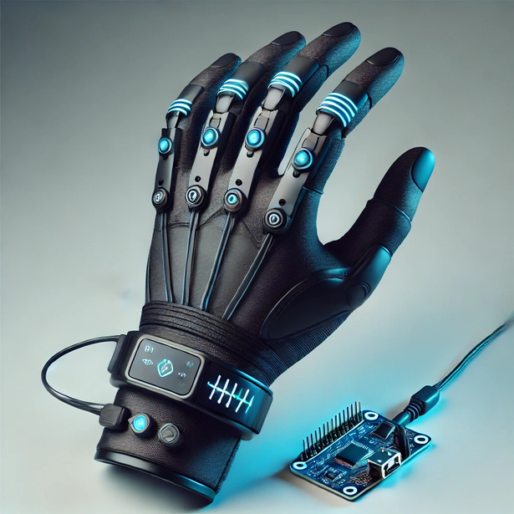
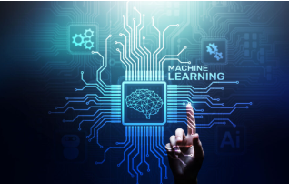
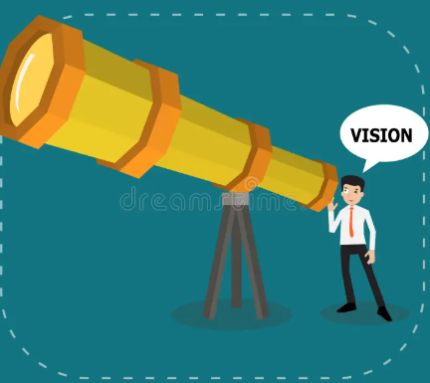
FUTURE SCOPE
AI-Powered Gesture Recognition :
Integrating Machine Learning (CNNs, LSTMs) can help the glove adapt
& learn new gestures with more accuracy and ease.
Multilingual & Customizable : Speech Output
Users can select their preferred language (English, Hindi, Telugu, etc.)
for speech conversion.
IoT Connectivity for Remote : Communication
Sending recognized text messages or voice output via Bluetooth/WiFi
to smartphones or hearing-impaired users.

Slide 9
REFERENCES

Slide 10
THANKYOU

